Slide 1
Generating Web Applications Using AI
CSE 110 Team 17 - CSS Crusaders
Notes:
Main page

Slide 2
What tools did we use?
Code Generation
ChatGPT (3.5)
Image Generation
Craiyon.com
Audio Generation
Murf.ai
Play.ht

Slide 3
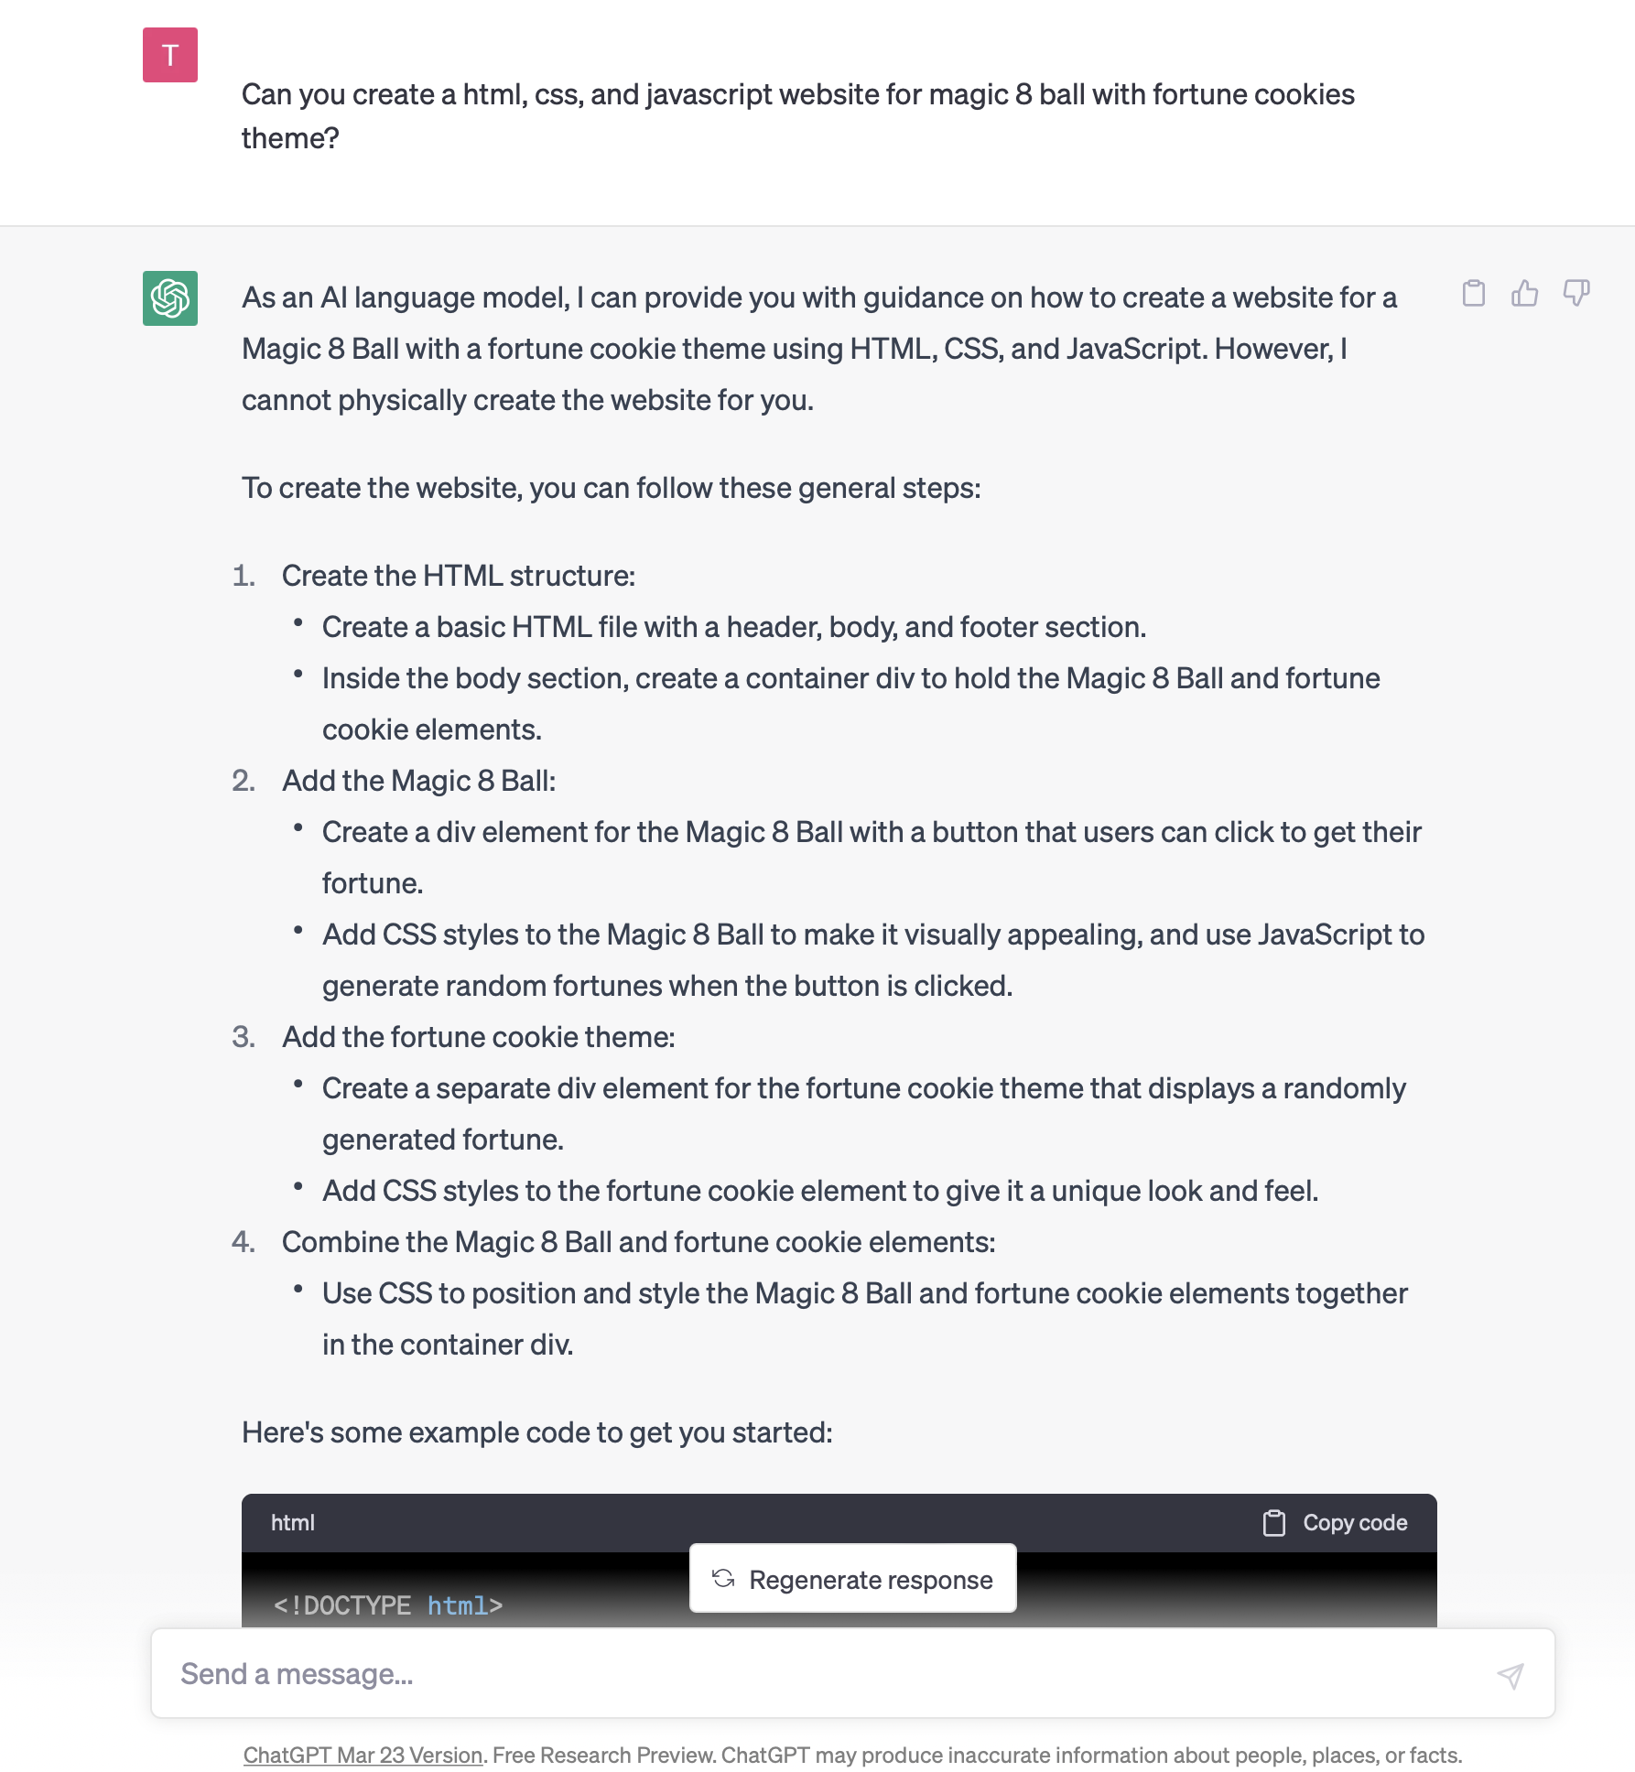
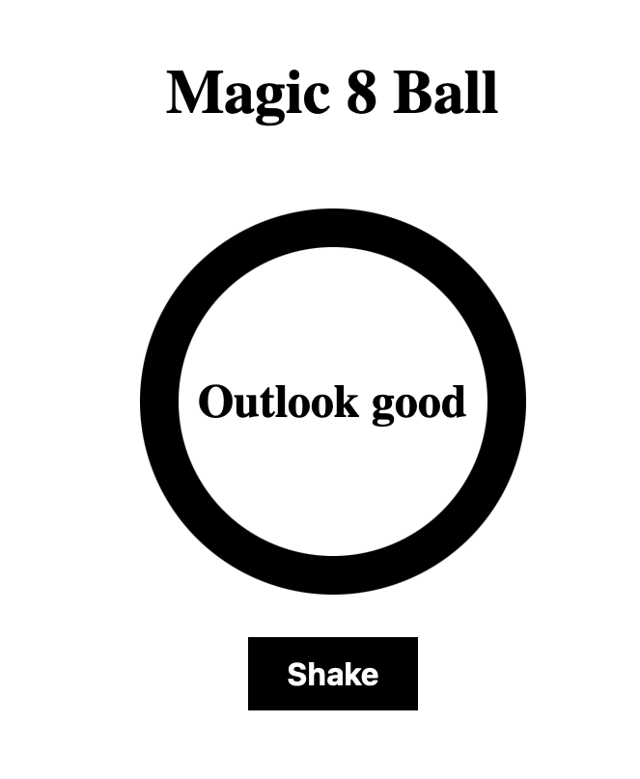
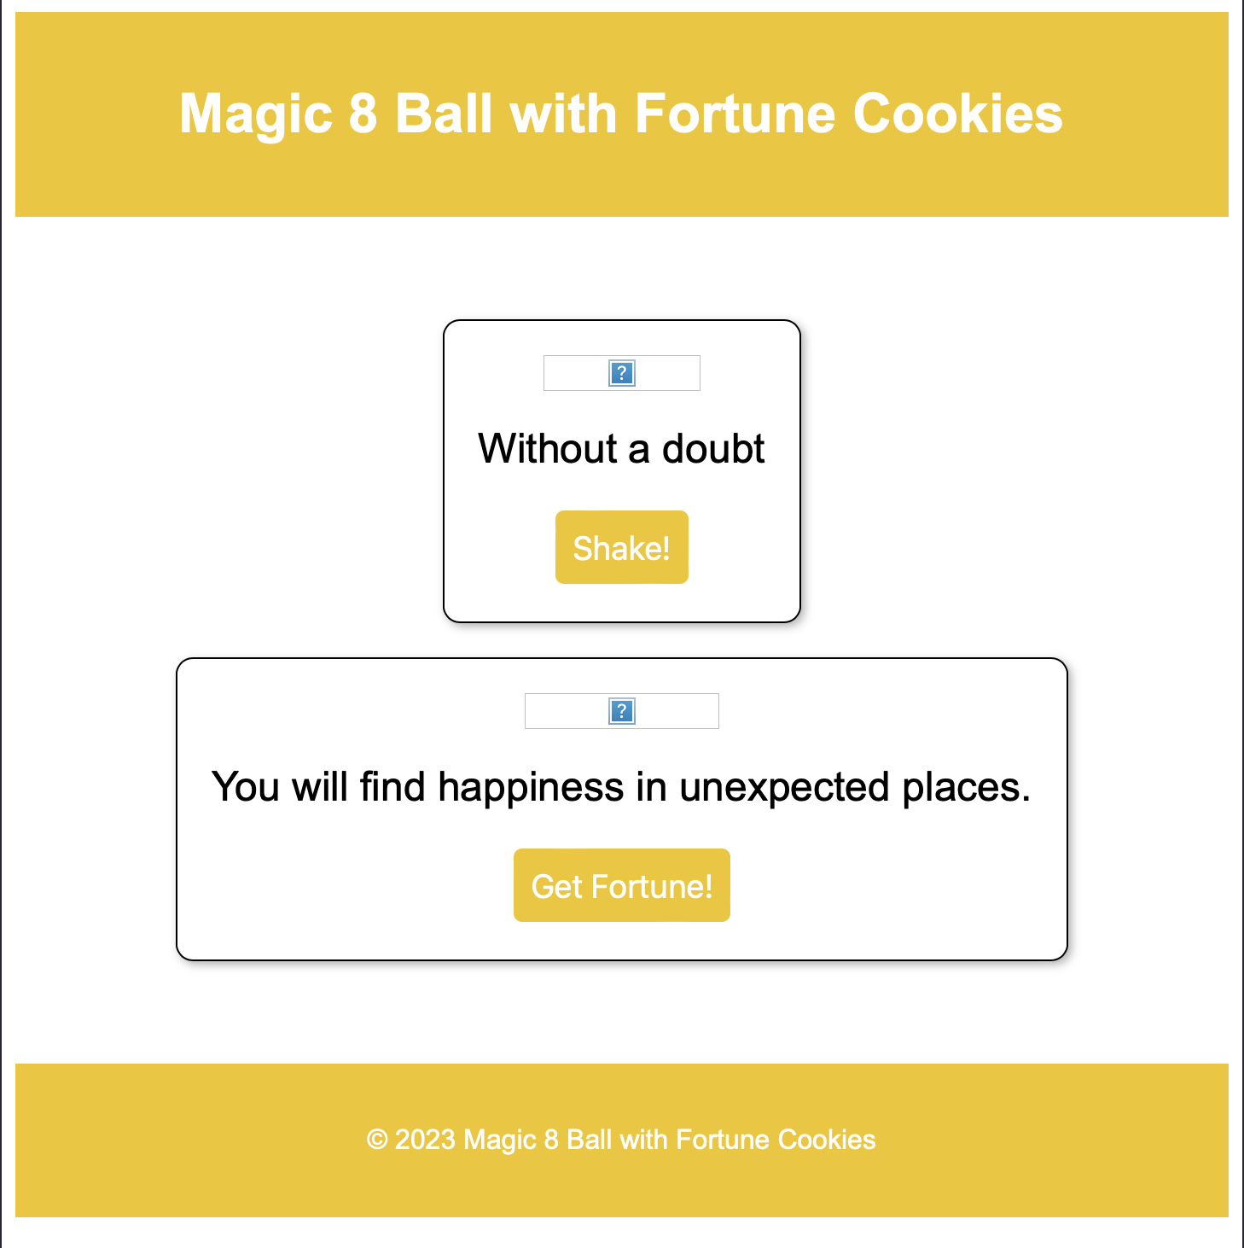
CHATGPT
Different chat with the same exact prompt and same exact user will give you different answers, which can be functional or not
One version have a better visual but not function well while the other version is functional and look more simple visually.
Sometimes the response is cut off
You can also ask it to debug for you, but it is very limited

Slide 4
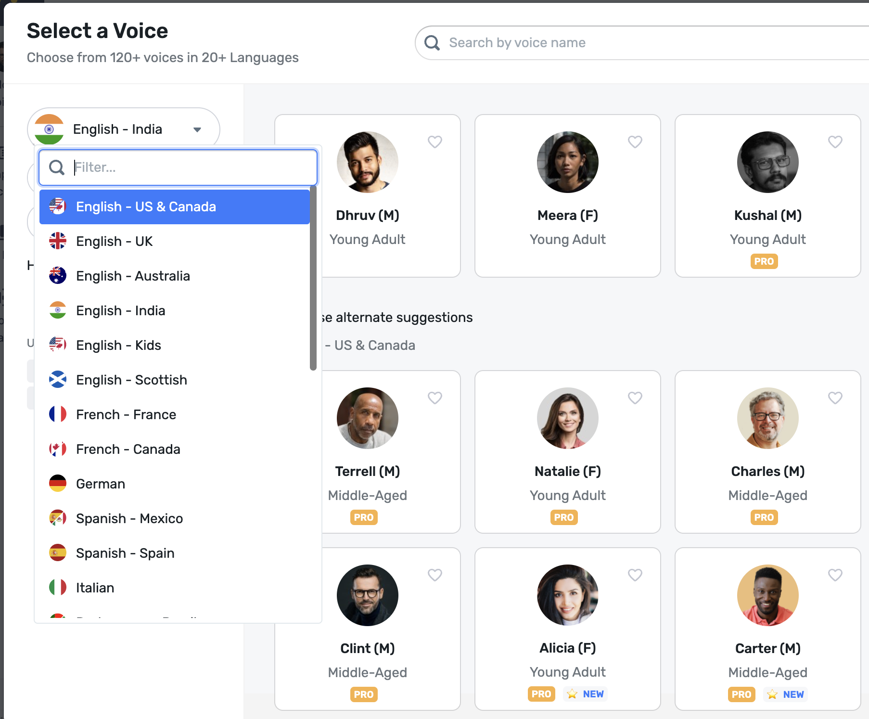
Audio Generation AI
Used Play.ht and murf.ai
Within a voice, was able to select intention(marketing, relaxing, etc)
Within a language, many accents are available
Some voices were so realistic that we sometimes forget that we are working with AI generated voices.

Slide 5
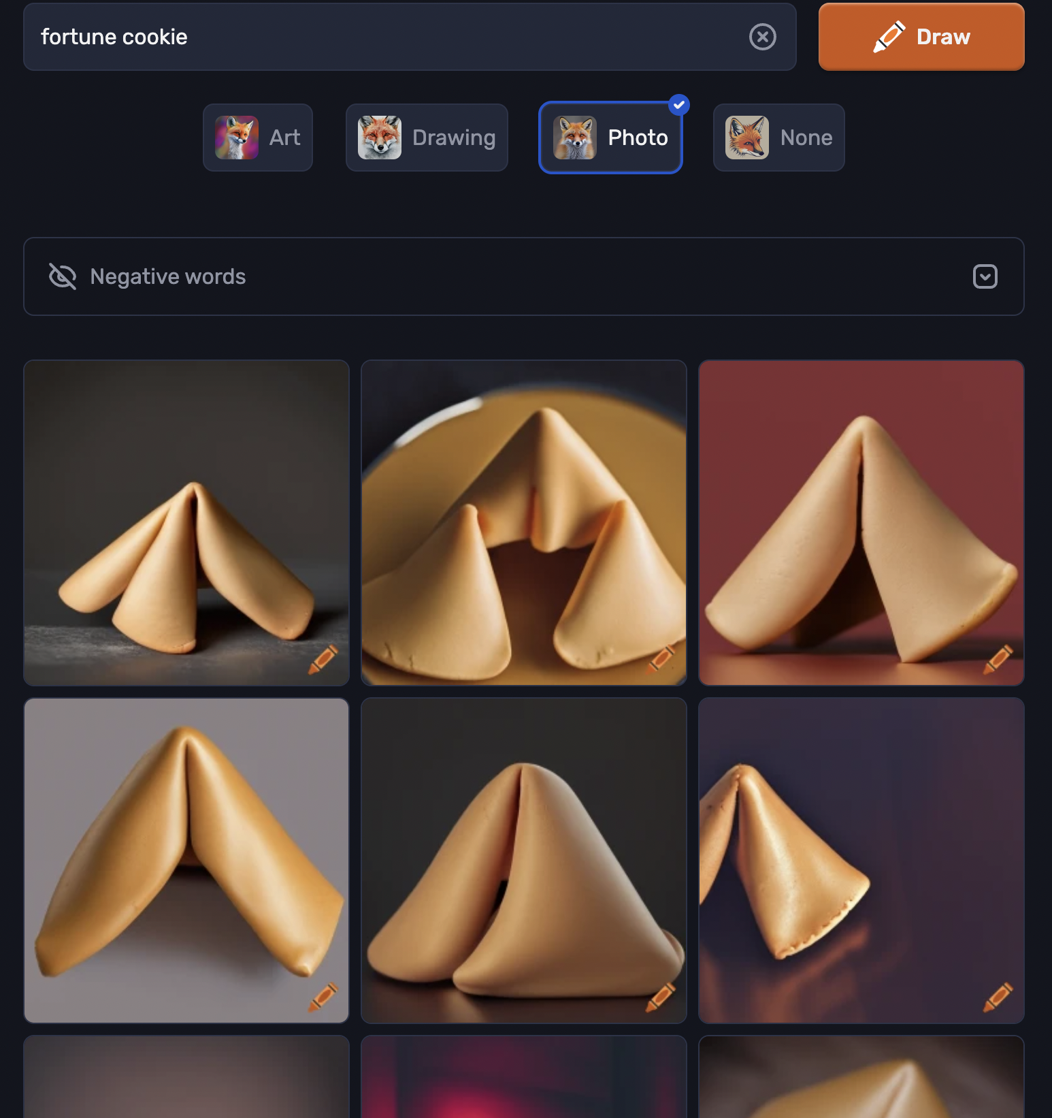
Image Generation AI
We used Craiyon
Users could input idea that they hope that the AI will draw
Not able to take too many words as an idea
May not give what you are looking for
Sometimes unrelated pictures are provided

Slide 6
Pros & Cons of AI
Pros:
Quickly construct web application within an hour
Good for debugging
Excellent for brainstorming
Answers questions quickly
Cons:
May not necessarily give functioning code
May not necessarily give you what you had envisioned
You have to have a good understanding of the subject that you are asking for help
Many cost money
Notes:
Loading page

Slide 7
How can AI help with web development?
Significantly speed up workflow
Quick to answer questions
Give “novel” ideas that you haven’t thought about
Can easily debug syntax errors
Can provide good templates for starting projects
Notes:
s

Slide 8
Improvements that can be made to AI
Allow users to upload images so that AI can build off you’re ideas and give you more of what you are looking for
Be able to input entire files of code for AI like GPT to parse in order to give a more seamless user-end experience
More memory threads to allow deeper conversations/generations

Slide 9
How can AI be detrimental to web development?
Programmers becoming less knowledgeable about the field and relying more on AI
Becoming more reliant on AI to produce working programs. Programs’ potential become limited by how advanced AI is and the data it has received rather than a programmer’s knowledge and experience
AI may lack an understanding of more complex systems

Slide 10
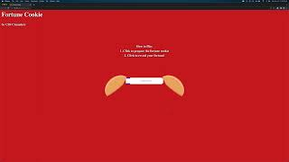
Final Product Created By AI Only!

